Slide 1
Analyzing Spending habits by Generation
File created on: 8/5/2023 8:05:47 AM

Slide 2
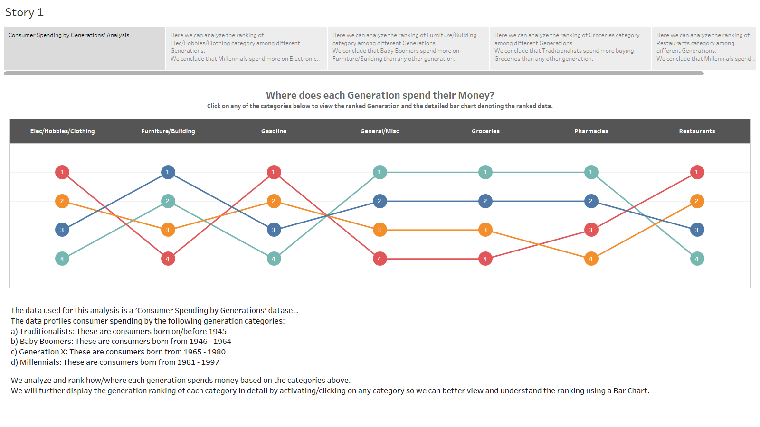

Slide 3
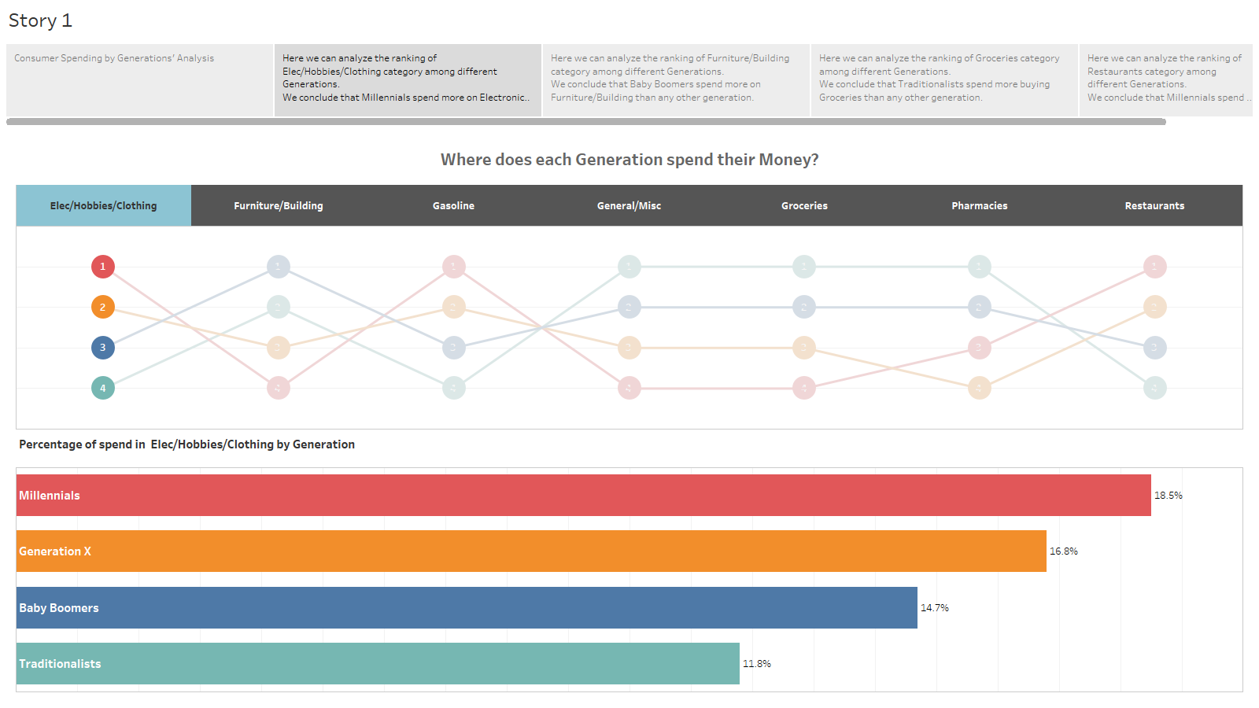

Slide 4
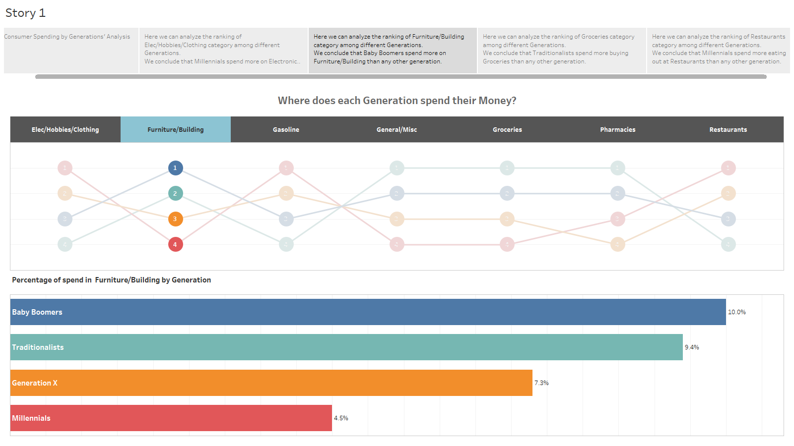

Slide 5
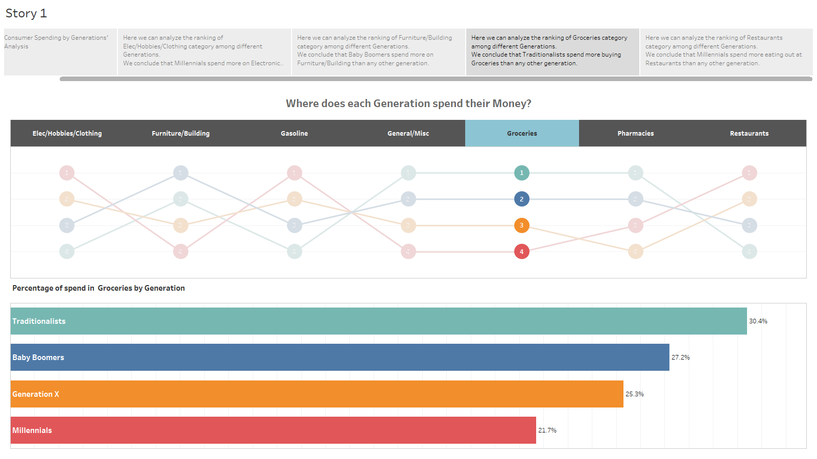

Slide 6
